Slide 1
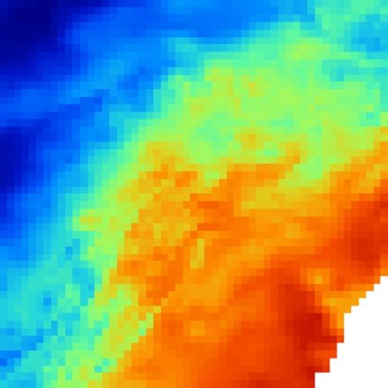
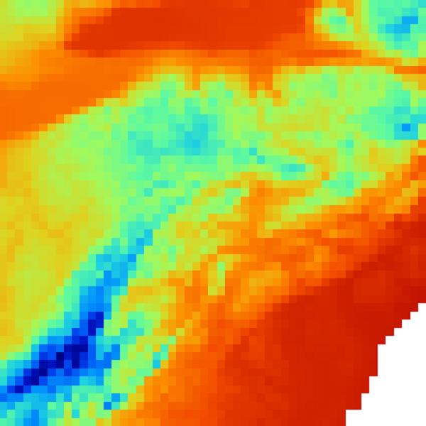
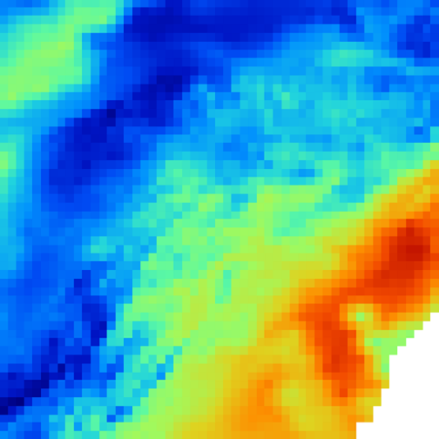
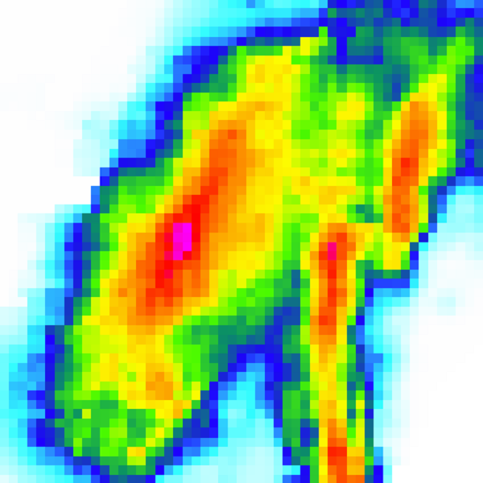
…
Humidity
Pressure
Temperature
Precipitation
Figure 1. Gridded values for the weather variables are available every hour from NLDAS

Slide 2
a.
Cell = (x - r … x + r, y - r … y + r)
X₁
X₂
X₃
…
X_{n}
Time = t - p … t - 1
X₁
X₂
X₃
…
X_{n}
Time = t
Cell = (x, y)
b.
Cell = (x - r … x + r, y - r … y + r)
X₁
X₂
X₃
…
X_{n}
Time = t - p … t - 1
X_{i}
Time = t
Cell = (x, y)

Slide 3
a.
X₁
X₂
X₃
…
X_{n}
Time = t - p … t - 1
Cell = (x, y)
X₁
X₂
X₃
…
X_{n}
Time = t
Cell = (x, y)
Cell = (x - r … x + r, y - r … y + r)
b.
X₁
X₂
X₃
…
X_{n}
Time = t - p … t - 1
X₁
X₂
X₃
…
X_{n}
Time = t
Cell = (x, y)

Slide 4
a.
Time = t - p … t - 1
X₁
X₂
X₃
…
X_{V}
Cell = (i, j)
X_{v}
Time = t
Cell = (i, j)
b.
Cell = (1 … s_{x} , 1 … s_{y})
X₁
X₂
X₃
…
X_{V}
Time = t - p … t - 1
X_{v}
Time = t
Cell = (i, j)

Slide 5
1.
Time = t
X₁
X₂
X₃
…
X_{V}
Cell = (i, j)
X_{v}
Time = t + 1
Cell = (i, j)
3.
Cell = (i, j) є S
X₁
X₂
X₃
…
X_{V}
Time = t
X_{v}
Time = t + 1
Cell = (i, j)

Slide 6
2.
Time = t - p … t
X₁
X₂
X₃
…
X_{V}
Cell = (i, j)
X_{v}
Time = t + 1
Cell = (i, j)
4.
Cell = (i, j) є S
X₁
X₂
X₃
…
X_{V}
Time = t - p … t
X_{v}
Time = t + 1
Cell = (i, j)

